Slide 1
CREDIT CARD APPROVAL USING MACHINE LEARNING

Slide 2
Contents
Introduction
Existing System
Proposed System
Block Diagram
Machine Learning Workflow
Algorithms
Results
Conclusion and future scope

Slide 3
Introduction
Credit card use is not always beneficial for everyone, and in some cases, it can result in significant financial losses.
Credit card fraud is on the rise. Increasing on a daily basis As the internet becomes more digital, As the use of credit cards for purchases grows, so does the use of debit cards. Online purchases.
There are numerous types of fraudulent transactions that can occur in a variety of situations methods with anyone, anywhere
Credit card companies must be capable to detect credit card fraud transactions in order to detect fraudulent transactions of products that the customer did not buy.
Data Science and machine learning are now assisting in the identification of these Transactions that are fraudulent Transactions involving fraud are common and helping the financial institutes to make an informed decision whether to approve credit card for a user or not.

Slide 4
Existing System
In existing system methods such as Cluster Analysis, SVM, Bayesian network, Logistic Regression, Naïve Bayes' , Hidden Markov model are used to find out the credit card approval for users.
The methods used in the existing system are based on unsupervised learning and the accuracy obtained by these methods is about 60-70%.

Slide 5
Proposed System
The proposed system overcomes the above mentioned issue in an efficient way. It aims at analyzing the number of fraud transactions that are present in the dataset.
In proposed System, we use Random forest, Decision tree and Logistic Regression to classify the credit card dataset.
Random Forest is an algorithm for classification and regression.
The dataset is classified into trained and test dataset where the data can be trained individually, these algorithms are very easy to implement as well as very efficient in producing better results and can able to process large amount of data.
Even for large dataset these algorithms are extremely fast and can able to give accuracy of about over 90%.

Slide 6
Introduction to Machine Learning

Slide 7
Block Diagram
Prediction
Testing Dataset
Model
Data
Algorithm
Evaluation
Training Dataset
Production data

Slide 8
Machine Learning Workflow
We can define the machine learning workflow in 5 stages.
Gathering data
Data pre-processing
Researching the model that will be best for the type of data
Training and testing the model
Evaluation

Slide 9
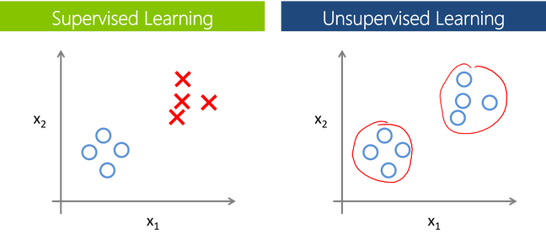
The machine learning model is nothing but a piece of code which an engineer or data scientist models by training it with the data according to the need of the project
Making the model learn through the data and allowing it to predict or give the solution that we want whenever we ask it to give.
So, whenever we give our model the new data which we want it to predict, we will get the predicted value according to the model training.
The trained model might or might not perform well on the test data that we want it to predict, due to various reasons,
So before trying to train any model we need to make sure that the algorithm that is going to use is appropriate for the desired class that we want to predict and based on the data that we are using.

Slide 10
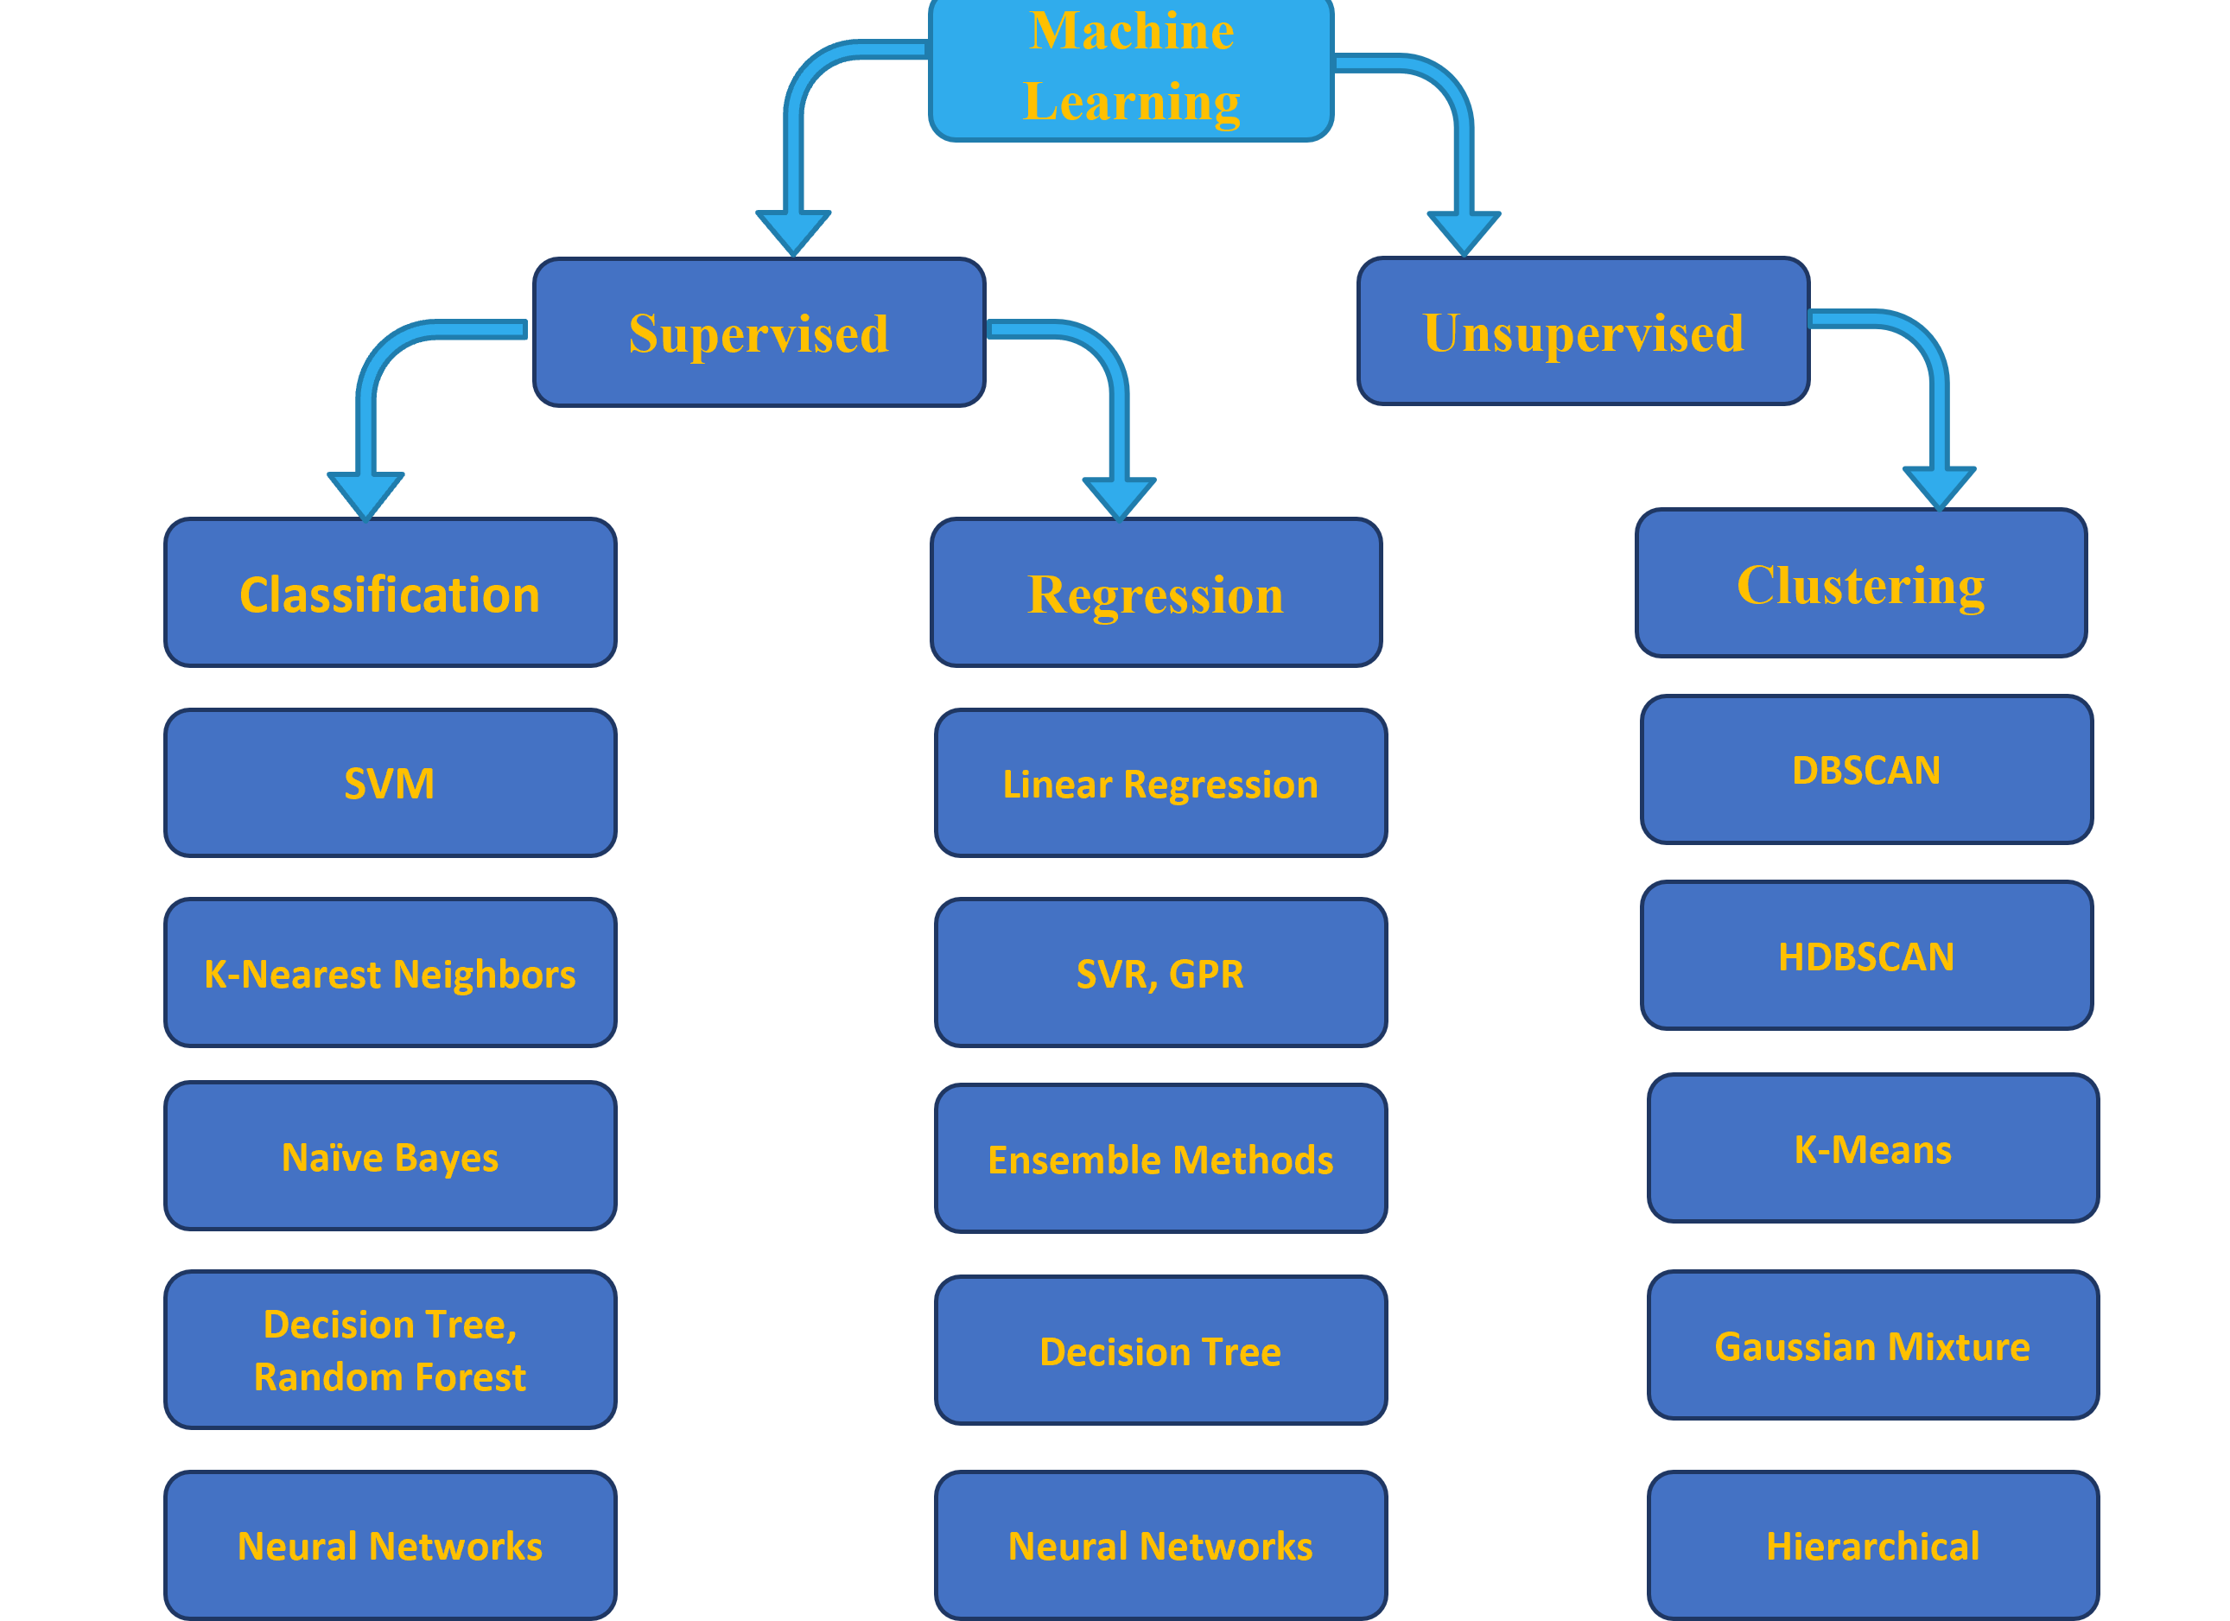
Overview of the Machine Learning Models

Slide 11
Training and Testing the model.
Training is the most important part, where we train our model using the data available and make the machine learn and understand the data.
When the model has learned from the data, we provide the model with another dataset to evaluate how good our model is performing, if it is performing well, we then test the model using test data, where we get to know the final performance of our model, which can be measure using various metrics, such as Accuracy, recall, precision, and through classification report.
This whole process of building and deploying a model is done using 3 different datasets which are split using train_test_split(), which are ‘Training data’, ‘Validation data’, and ‘Testing data’.

Slide 12
Algorithms Used

Slide 13
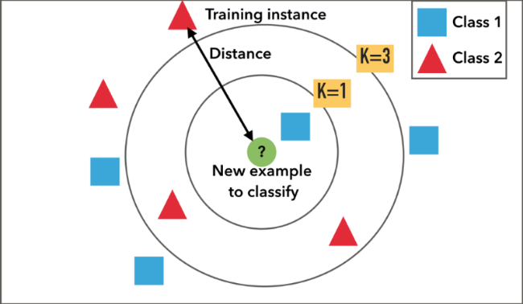
Algorithms(1/3)
K-Nearest Neighbor Classifier
K-Nearest Neighbors is one of the most basic yet essential classification algorithms in Machine Learning.
It belongs to the supervised learning domain and finds intense application in pattern recognition, data mining and intrusion detection.
It is widely disposable in real-life scenarios since it is non-parametric, meaning, it does not make any underlying assumptions about the distribution of data (as opposed to other algorithms such as GMM, which assume a Gaussian distribution of the given data).

Slide 14
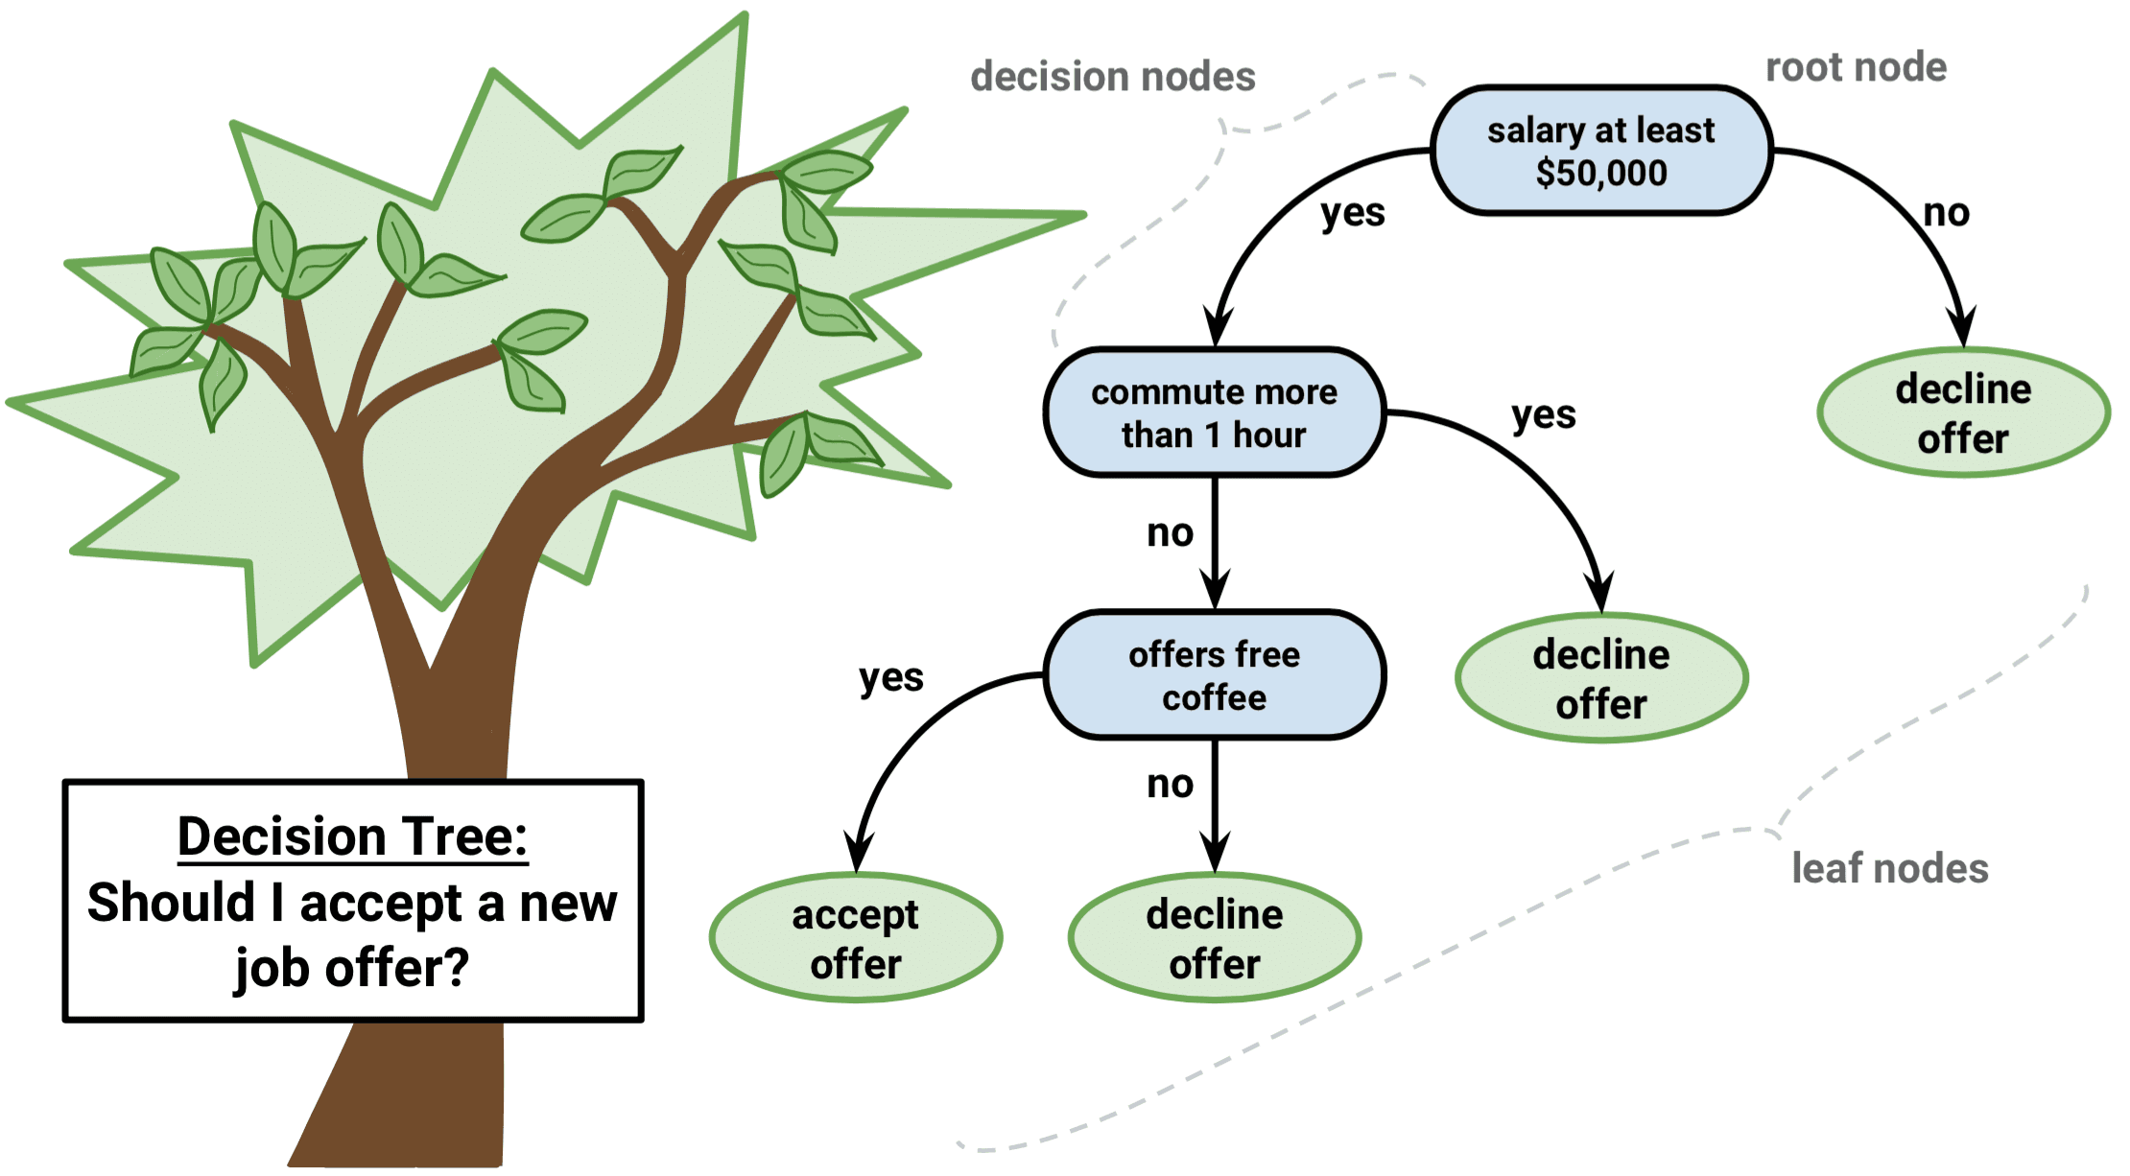
Algorithms(2/3)
Decision Tree
Decision tree, as the name suggests, creates a branch of nodes
Where each internal node denotes a test on an attribute, each branch represents an outcome of the test, and the last nodes are termed as the leaf nodes
Leaf node means there cannot be any nodes attached to them, and each leaf node (terminal node) holds a class label.
The decision tree is one of the most popular algorithms in machine learning, it can be sued for both classification and regression.
There are some exceptions to decision tree also, in terms of data scaling and data transformation, since decision tree works like a flowchart in the form of branches doing data transformation and scaling might be optional.

Slide 15
Results

Slide 16
MODELS COMPARISION
MODEL 1
(Decision Tree)
MODEL 2
(K-Nearest Neighbour)
Training | Testing
95% | 91%
99% | 87%
91% | 96%
95% | 91%
Training | Testing
92% | 90%
92% | 90%
92% | 90%
92% | 90%
Accuracy
Precision Score
Recall
f1_Score

Slide 17
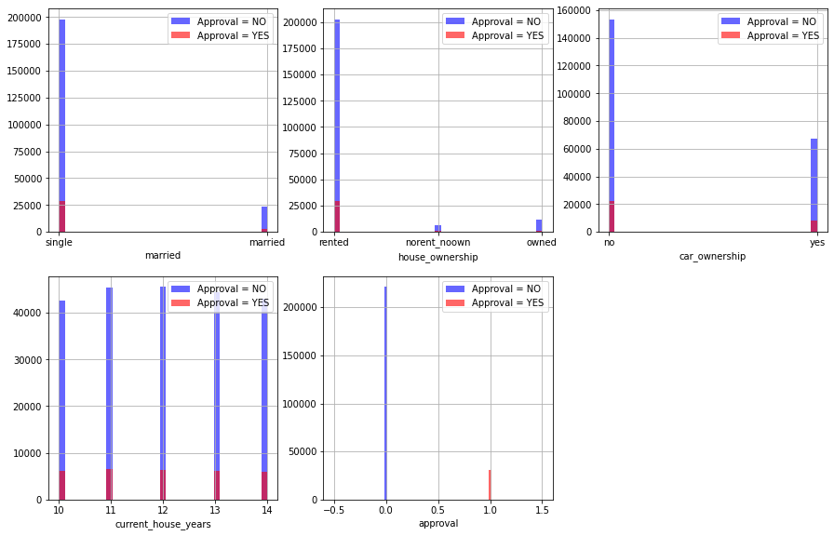
Count of Target Class

Slide 18
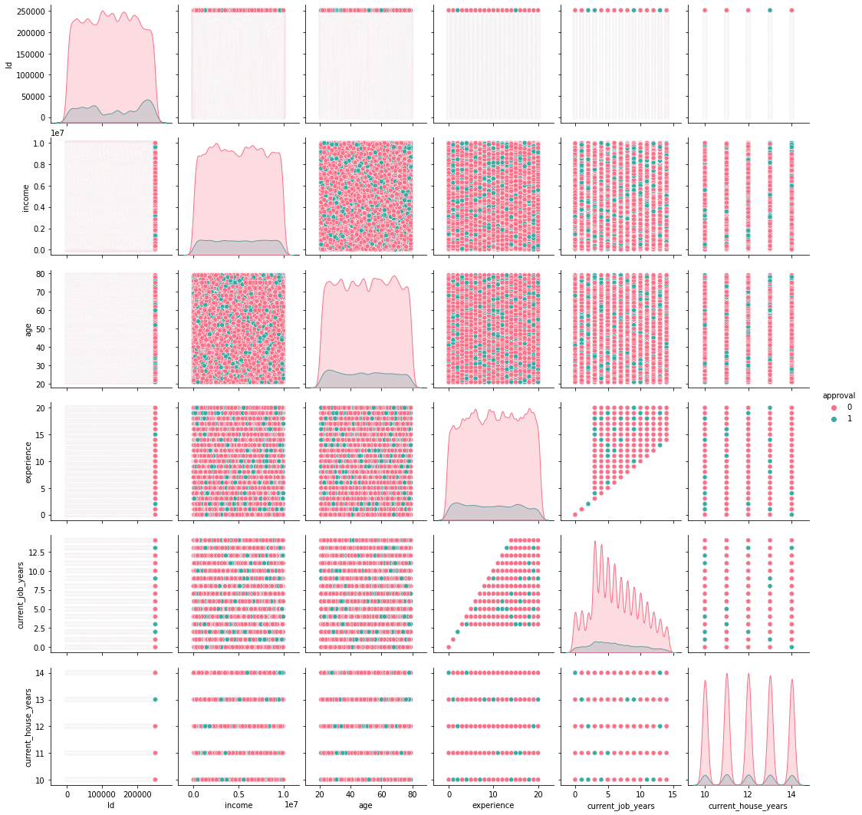
Pair Plot

Slide 19
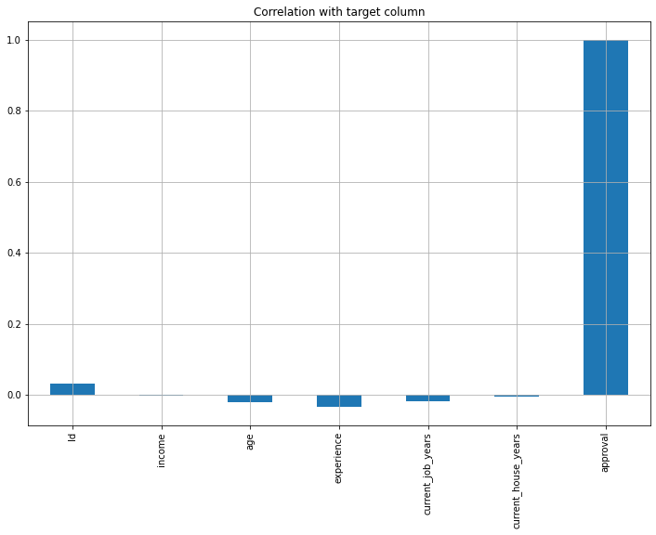
Correlation with Target Column

Slide 20
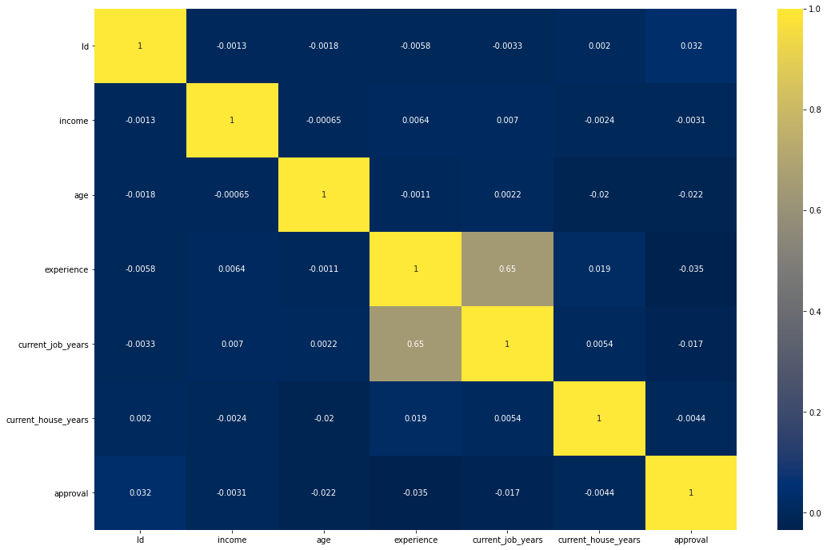
Correlation Matrix of independent variables

Slide 21
Conclusion
As per the main objective of the project is to classify and identify the Credit Card fraudsters and approval of cards for the users based on ML algorithms is being discussed throughout the project.
Credit card fraud and approval is most common problem resulting in loss of lot money for people and loss for some banks and credit card company.
This project want to help the peoples from their wealth loss and also for the banked company and trying to develop the model which more efficiently separate the fraud and fraud less transaction by using the time and amount feature in data set given in the Kaggle.
we build the model using some machine learning algorithms such as logistic regression, decision tree, Random Forest, these all are supervised machine learning algorithm in machine learning.
As part of the future scope, we hope to try out different algorithms to optimize the feature output process, increase the feature similarity of data to improve the model's representation capability.

Slide 22
Thank You

